Slide 1
CadrRes plots
-AANCHAL MONGIA Oct 7, 2019

Slide 2
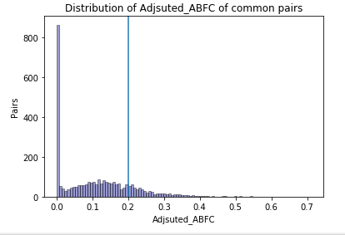
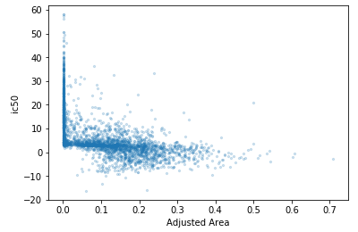
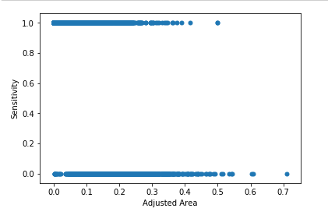
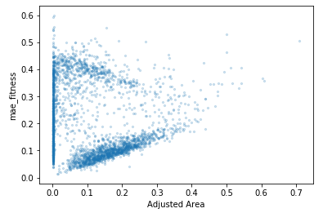
..
Distribution of ABFC
OLD
Explanation of cut off chosen; whyc= not cut in between bimodal? (plot ic50 mode against area)
Y high maw and low area for consistent pairs?; bcz DNW have high mae

Slide 3
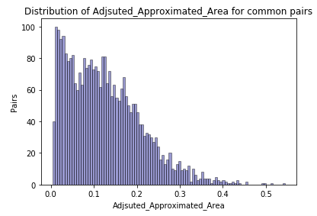
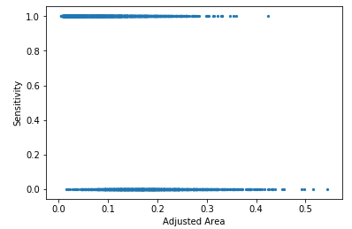
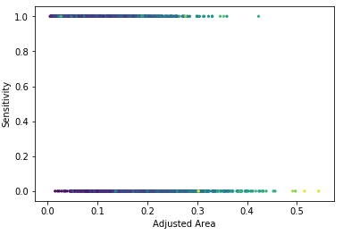
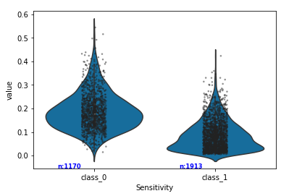
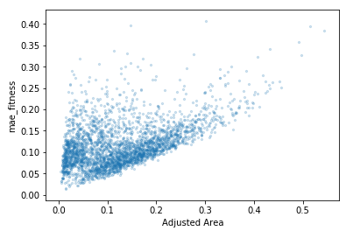
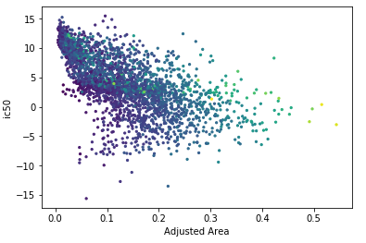
Distribution of AAA (Adjusted Approximated Area )
NEW
pvalue=3.62e-270
1: resistant
0: sensitive
AAA
Diff drugs woud have diff max dosage, so higher ic50 may nt always mean insensitivy.

Slide 4
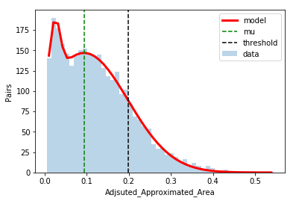
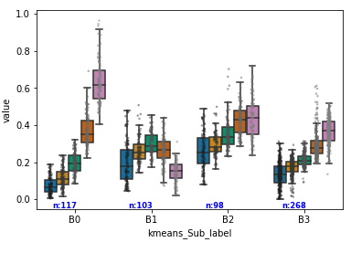
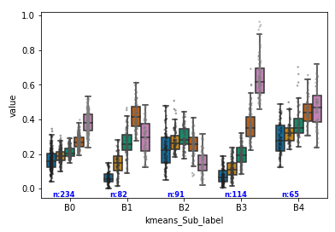
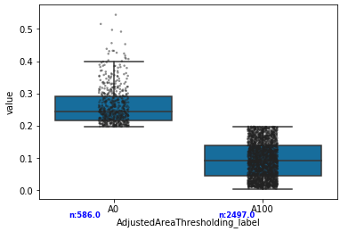
Choosing AAA threshold / Level 1 custering
AAA

Slide 5
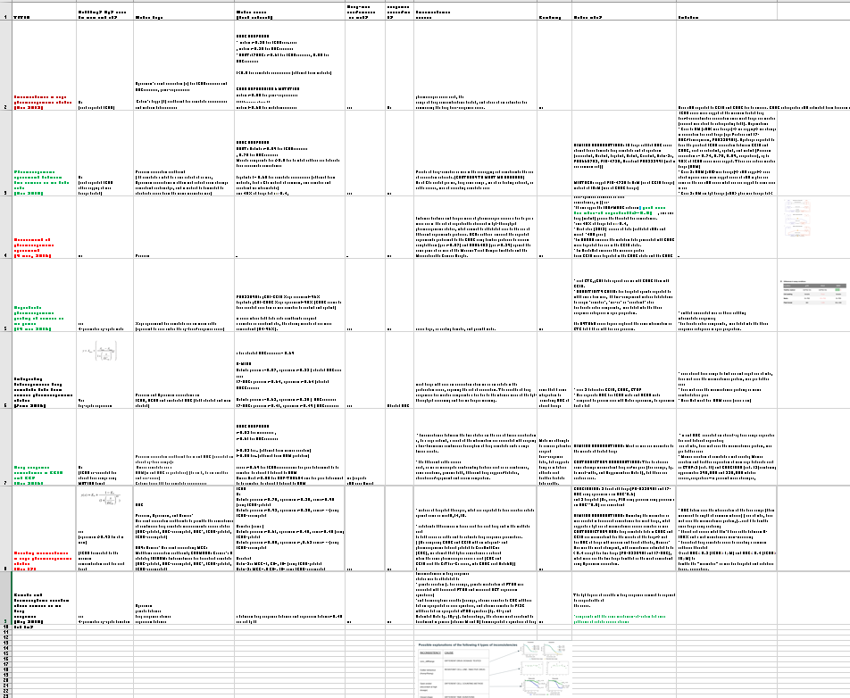
Lit review: Analysis/LiteratureReview.xlsx

Slide 6
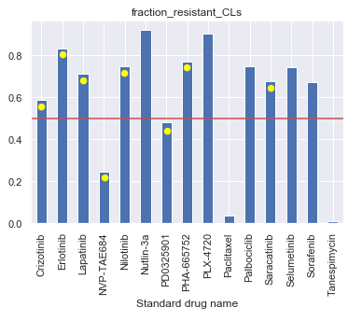
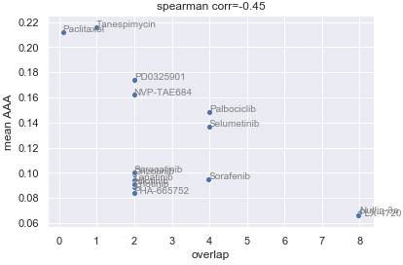
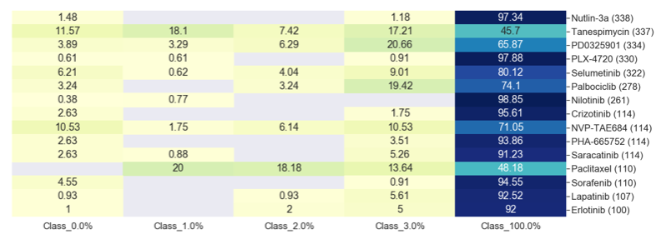
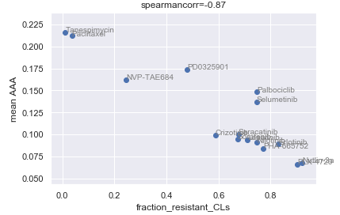
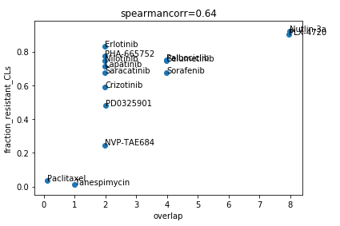
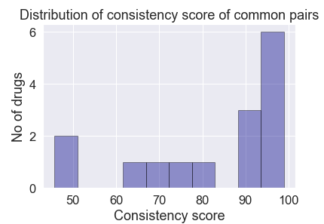
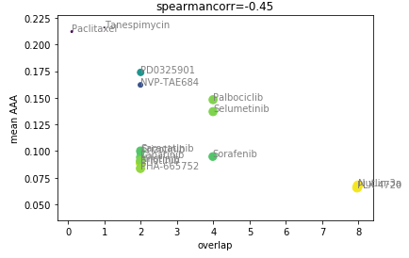
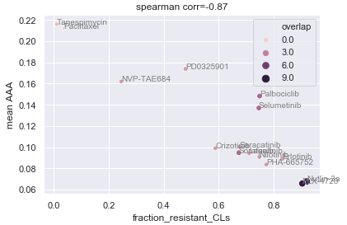
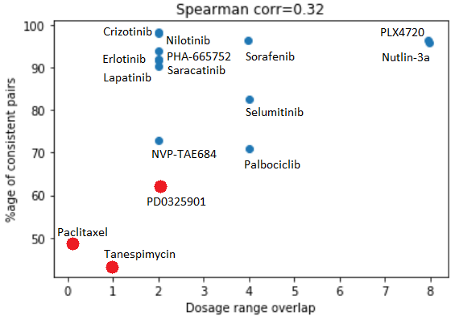
Drug-level analysis
(Factors: overlap, #resistant CLs)
No Area threshold used in these plots (just AAA of pairs and dosage range of drugs used)
=> Every drug has been tested for at least 100 CLs , so no need for filtering
Combining them not helpful since highly correlated
Low overlap and mostly sensitive CLs=> inconsistent
Med overlap=> if mostly insensitive CLs => consistent, else=> inconsistent
High overlap and mostly insensitive CLs => consistent
s
Notes:
Since biomarkers are to be found for each drug separately, it is vital that pharmacological profiles are highly consistent at the level of individual drugs and not merely when averaged across a larger dataset.

Slide 7
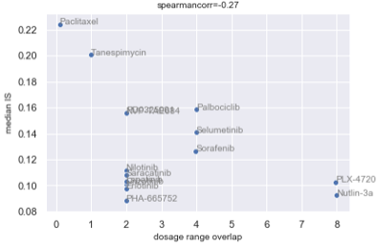
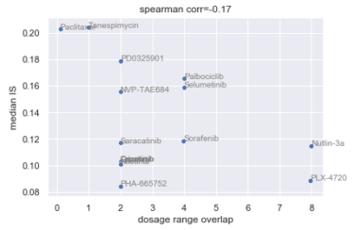
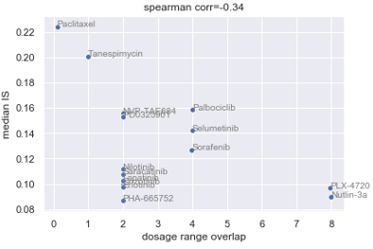
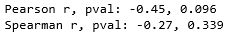
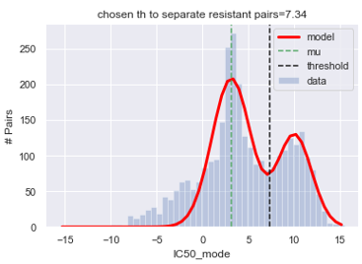
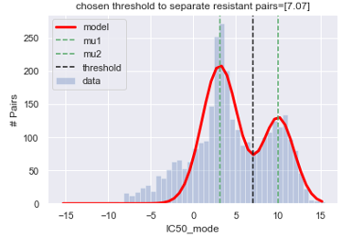
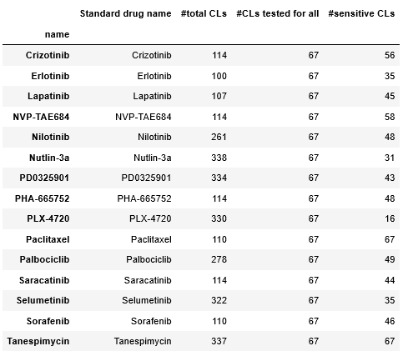
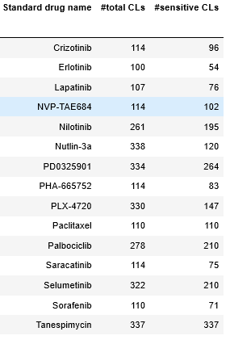
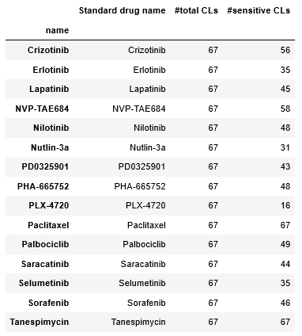
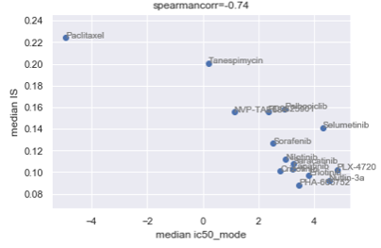
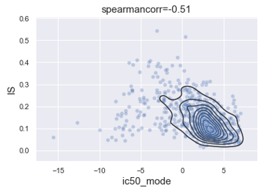
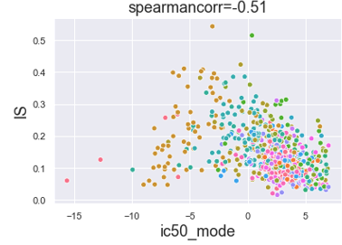
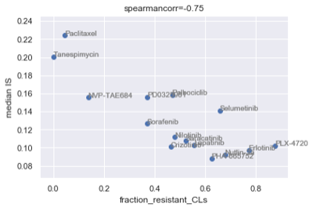
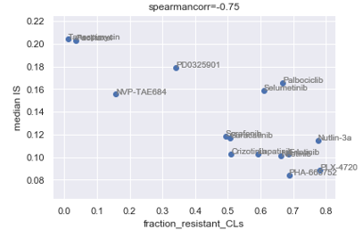
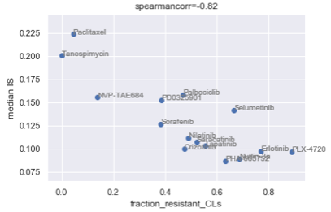
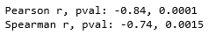
Perform analysis only of DW pairs so that low IS pairs (lot of near 0 AAA) do not make the results biased
* ic50 mode >max dosage => resistant (has some pairs which work on high dosage)
* Th ic50_mode (chosen ic50_mode as the value at which y/#Pais is min between the 2means of the modes at 2 stddev from mean of 1sr mode which corresponds to resistant pairs )
* Th IS or AAA (if u do that resistant or low IS class has some highly consistent working pairs)
Overlapping range not on log-scale
Drugs tested with less overlap (tested with less range in GDSC since CCLE dosage range=const) tend to be inconsistent RULE 1 / GENERALIZE: Drugs tested with less range (in GDSC since CCLE dosage range=const) tend to be inconsistent
* 2111 sensitive pairs selected
Considered Sensitive CLs which have been tested for all 15 drugs (688 CLs)
Trend for all pairs
Ic50>max dosage
*Removed bias from too high area pairs by taking median instead of mean *Remove bias from CLs which haven’t been tested for all drugs (these CLs might make a drug appear bad or good since other have not even been tested for these)
*Removed bias from resistant CLs by taking only sensitive CLs
Since these drugs worked on low dosage, these wee not tested further? How is dosage range decided?
RULE 2 / GENERALIZE: : :Cytotoxic drugs tend to be inconsistent Targetted drugs with high ic50 tend to show consistent response

Slide 8
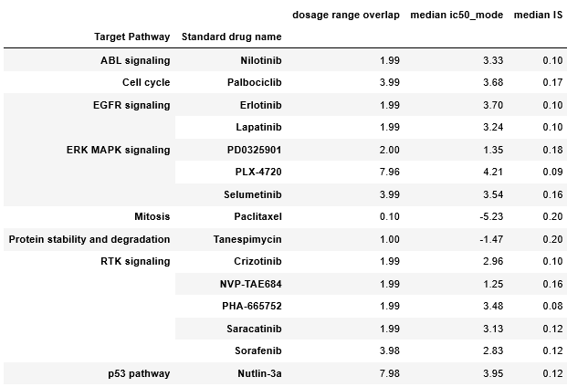
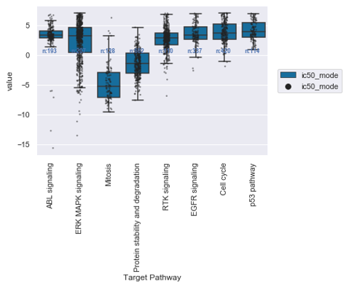
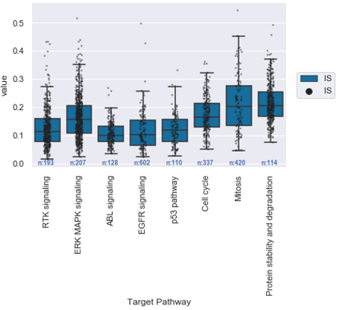
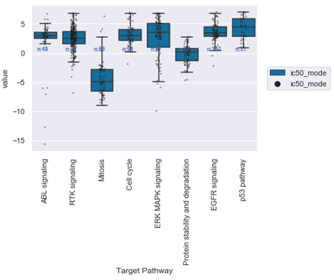
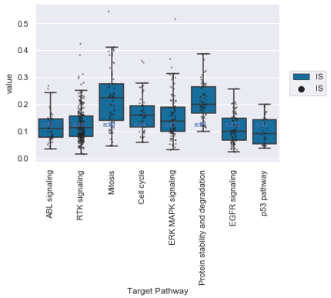
Do drugs with specific target pathway exhibit inconsistency?
Even though more no of drugs have “EGFR“, “ERK MAP signalling” and “RTK sigbnalling”, then also median IS for these pathways/moA is lower. RULE 3 / GENERALIZE: Drugs with these 2 pathways tend to be inconsistent
moA for which show lower IS contribute to less sensitive pairs in the common set.
Considered Sensitive CLs (2111 CLs)
There could be other sources also like assay, time bt no data to check that.

Slide 9
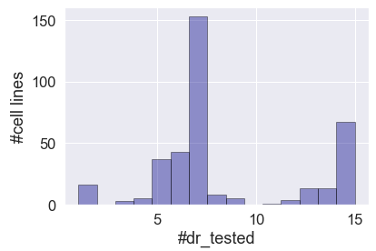
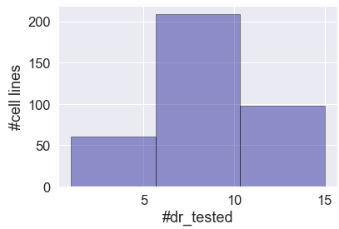
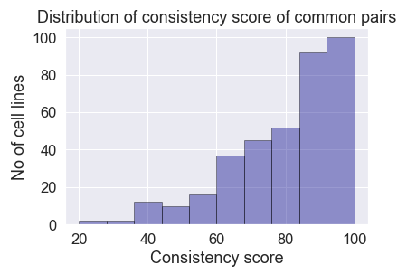
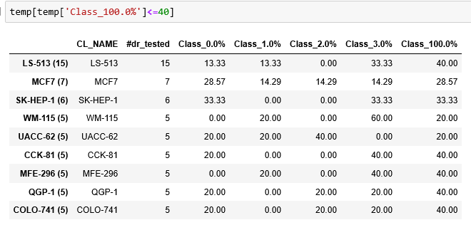
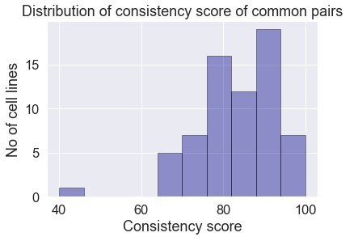



Cell line - level analysis
Nbins=3
=> Except 1st, all other have been tested for too ew drus to make a co nclusion
Nbins=15
=> Chose cell lines which have been tested for at least 5 drugs
Chose cell lines which have been tested for all 15 drugs
Since we want to be very sure of the conclusion we make and hence stringent on he cell line selection criteria (already 15 drugs is not too many for a concrete conclusion)
Chose cell lines which have been tested for at least 11 drugs

Slide 10







Median =0.70
1 data point is 1 cell line
Drug wise spearman corr
Paclitaxel : -0.1 Tanespimycin : 0.03 PD0325901 : 0.02 NVP-TAE684 : -0.0 Palbociclib : 0.04 Crizotinib : -0.03 Erlotinib : 0.09 Lapatinib : 0.09 Nilotinib : -0.0 PHA-665752 : 0.02 Saracatinib : -0.11 Sorafenib : 0.01 Selumetinib : 0.04 Nutlin-3a : -0.01 PLX-4720 : -0.02
MUT
Notes:
K=(Po-Pe)/(1-Pe) where p_{o} is the relative observed agreement among raters (identical to accuracy), and p_{e} is the hypothetical probability of chance agreement,
K=0 => Po~Pe => agreement by chance, k<0=> agreement worse than by chance
http://www.iiisci.org/journal/CV$/sci/pdfs/GS315JG.pdf
Hamming simi: 1-distance.hamming([1, 0 ,0, 0 ,0, 0 ,0, 0 ,0, 0 ], [1 ,1, 0, 0 ,0, 0 ,0, 0 ,0, 0 ])=0.9 <= fraction of bit positions which are same
Jaccard simi: 1-distance.jaccard([1, 0 ,0, 0 ,0, 0 ,0, 0 ,0, 0], [1 ,1, 0, 0 ,0, 0 ,0, 0 ,0, 0])=0.5 <= excludes negative matches

Slide 11





1 data point is 1 Pair
Conc CLs
Drug wise spearman corr (Conc CLs)
1 data point is 1 cell line
Dis CLs
MUT

Slide 12


Cancer genes from CELL AAA vs diff in muts
for sure there is trend, bad CLs don’t show response in gdsc ..higher is the diff bw #muations higher is the response diff
Drug wise spearman corr (Dis CLs)
Higher the no of mutations for CLs with discordant mutation profiles=> lower the ar or no response
Hih #mutations in GDSC=> High diff => no response in GDSC=>inconsistent response for effective drugs and consistent for inactive drugs
MUT

Slide 13


40 bad CLs
MUT

Slide 14



Ic50 of gdsc better correlates with diff in mutation
MUT

Slide 15
Which cancer genes to use?
OPTIONS:
April, 2018: CELL ppr (Comprehensive Characterization of Cancer Driver Genes and Mutations)
Sep, 2018: Cell model passport ppr (Cell Model Passports—a hub for clinical, genetic and functional datasets of preclinical cancer models)
Oct, 2018: COSMIC ppr (The COSMIC Cancer Gene Census: describing genetic dysfunction across all human cancers)
MUT

Slide 16






variation of inconsistency with difference in gene mutation
MUT

Slide 17





*Bias due to diff in gene scale correct by subtracting mean
*Ed scaled in range 0 to 1 and subtracted from 1 to get similarity based on ED
No pattern in IS vs GE profile similarities
Per drug correlation:
No pattern in IS vs med GE (avged across ccele and gdsc)
Per drug correlation:
GE

Slide 18
GE analysis
Corr after removing bad drugs
Corr after removing bad pairs from bad drugs
Corr after removing bad pairs from bad drugs and bad CLs
%age of pairs outside 1 std from mena of AAA dist

Slide 19


Tissue - level analysis
No pattern?
Consistency score

Slide 22







Correlation between new ABFC and old ABFC
OLD
NCIH-1648,Erlotinib
NCIH-1666,Paclitaxel
JVM-3,Paclitaxel
SK-N-DZ,Sorafenib

Slide 23
















OCI-AML2,Selumetenib
OLD
Fed new data->still unable to capture inconsistency (too tight fitting)
TRIED: different models(flat, hierarch, shared prior), repeated runs, data with only 1 pair
REASON FOUND: All drugs were fed at a time for 1 cell line (problem with JAGS syntax, if data rom multiple drugs/subjects is sent, fitting is not independent)
SOLUTION: Fitting should happen 1 drug or pair at a time (switched to previous model wit flat structure)
OPTIONS: tried increasing no of iterations(didn’t work), tried fitting with half no of drugs, got intermediate results
OCI-AML2,PD0325901
All drugs in ip
Half drugs in ip
2 drugs in ip
1 drug in ip
Problem: data which was fed was not correct (had replicates)
Hence, problem with JAGS syntax, if data rom multiple drugs/subjects is sent, fitting is not independent Also, time taken to fit per cell line also reduced
FLAT_ALL PAIRS_IN_IP FLAT_1PAIR_IN_IP
TE-11 12 sec 10 sec
JVM-3 20 sec 17 sec
OCUM-1 9.3 sec 7.5 sec
Changed nu to 1+exp(1/29) (visually almost same results as before with nu ~exp(1/30) )
Diff bw old and new: Flat vs heirarch, nu changed
Notes:
Summary:
We wanted to 1) convert .ipynb notebook to command line-python script
2) save fitting results CL-wise (save 1 csv file for 1 CL instead of 1 pair to save space I case of large datasets like GDSC)
Nok helped convert the scipt since I was busy converting project400 script
She observed that old model had a hierarchical structure; fixed that by giving option o run a) shrinkage but with pyjags b) no shrinkage
Fitting results were not the same corr=0.88); new fitting couldn’t capture the inconsistency, hdi was too tight
I re-ran fitting with 1)shrinkage 2) Flat-1pair, Flat-allPairs 3) Hierarch-1pair, Hieararch-allPairs
OBS: Feeding 1 pair at a time better captured the inconsistenv
So, I switched to previous mode (format which took 1 pair for curve fitting) with flat structure. Also changed normality parameter (nu) to [1+exp(1/29)] instead of [exp(1/30)].

Slide 24











Corr between new and old approximated area
NEW
H4, tanespimycin (0.45 old, 0.23 new)
MOLT-16, palbociclib (0.51 old, 0.22 new)
22RV1, PLX-4720 (0.001 old, 0.06 new)
RKO, saracatiib(0.5 old, 0.08 new)
A2780,Selumetinib (0.003 old, 0.216 new)

Slide 25













Corr between new and old m, ic50, mae
NEW
639-V, Nilotinib(0.09 old, 0.63 new)
A253, PLX4720 (48 old, 10 new)
COLO-320-HSR, sorafenib (0.41 old, 0.05 new)
7860,Palbociclib (old 0.008, 0.260 new)
42-MG-BA, Nutlin3a (0.02, 0.47)

Slide 26








extras
Using all 1601 genes common bw ccle and gdsc

Slide 27



extras
Drug-wise corr for all common Cls (no separated based on jaccard)
Median =0.70
Distribution of jaccard similarity between mutatin profiles of common CLs *1 data point is 1 cell line

Slide 28



Cancer genes from CELL AAA vs mean muts
for sure there is trend, bad CLs don’t show response in gdsc ..higher is the diff bw #muations higher is the response diff
Drug wise spearman corr (Dis CLs)
Higher the no of mutations for CLs with discordant mutation profiles=> lower the ar or no response

Slide 29


Cancer genes from CMP
for sure there is trend, bad CLs don’t show response in gdsc ..higher is the diff bw #muations higher is the response diff
Drug wise spearman corr (Dis CLs)

Slide 30


Cancer genes from COSMIC
Drug wise spearman corr (Dis CLs)

Slide 31
Things to be noted
Drug-level analysis:
Factor 1: meanAAA comprises all pairs (both sensitive resistant)
Factor 2: Fraction of resistant CLs is derived from mode ic50 (captures behavior from both datasets not 1)

Slide 32


For all drugs except NVP, Paclitaxel, PD, Tanespimycin, the IS negatively correlates with ic50_mode

Slide 33


